Slide 1

Invest in Security

Slide 2
Contents
01
COMPANY BACKGROUND
02
BUSINESS ACTIVITIES
03
OUR PRINCIPALS

Slide 3
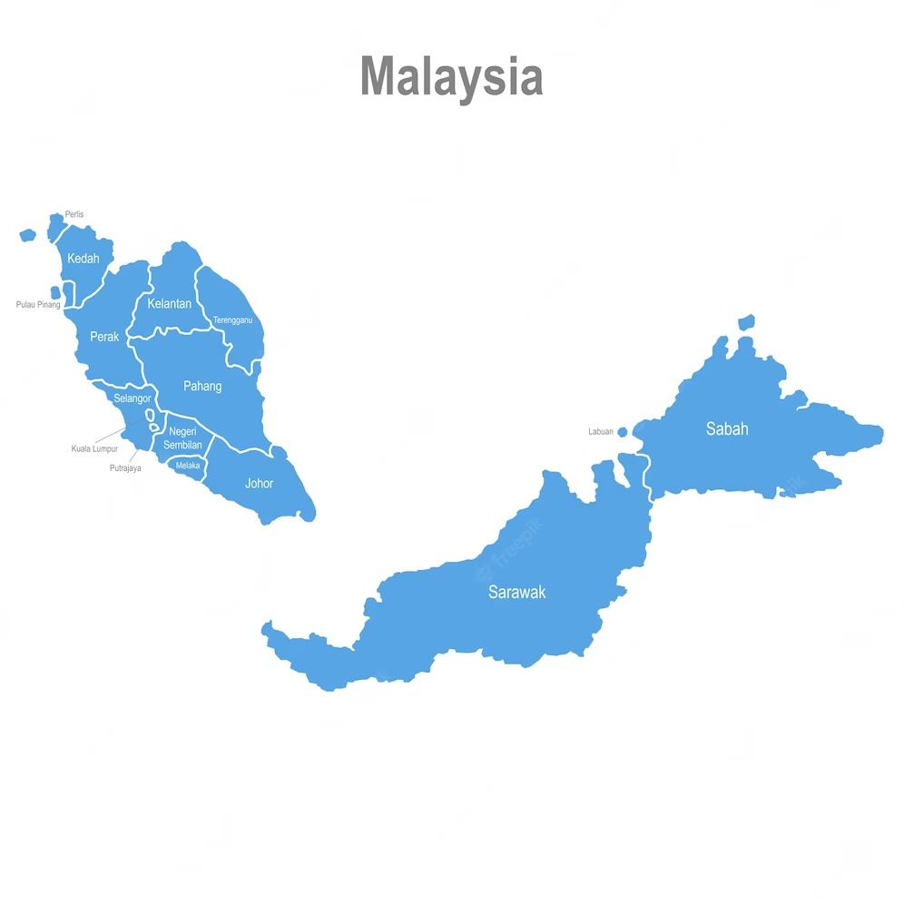
INTRODUCTION
COMPANY NAME : HORNBILL ENVIROTECH SDN BHD
202301003665(1497584-K)
HEAD OFFICE ADDRESS : Floor 2, LT 320, SL 7, Jalan Satok,
93400, Kuching, Sarawak
OPERATION OFFICE :
(1) KL Branch : No.11, Jalan Saujana Indah 10, TamanPerindustrian Saujana Indah, Seksyen U2, 40150,Shah Alam, Selangor Darul Ehsan.
(2) Bintulu Branch : 2nd Floor, No.186, Lot 7774, Assyakirin Commerce Square, Jalan Sultan Iskandar,
97000,Bintulu, Sarawak
(3) JB Branch : 20,Jalan Senangin 5/1,
Taman Pasir Putih,
81700,Pasir Gudang,Johor
Vision & Mission
Our Vision
Contribute growth in reliable cybersecurity and IT solutions that empower organizations to thrive in a digitally connected world, ensuring the highest level of data protection, privacy and operational resilience in Sarawak and Malaysia
Our Mission
To safeguard the digital future of businesses and individuals by delivering cutting edge IT solutions services.
Shah Alam
Pasir Gudang
Bintulu
Office
Workshop
Kuching
Notes:
12,000 sqft

Slide 4
Organizational Chart
Managing Director
Muhamad Adnan
General Manager
Assistant
General Manager
Business Development Senior Manxager
Amir Mushannif
Mohd Hafiz
Ahmad Jani
Head of BD & Sales
Head of
HRM
Head of
Project
Ilham Nurarif
Maisarah
Amirul
Logistic Admin
Finance
3D Scanning
Green Solutions
Workshop
Cyber Security
Sales Engineers
Equipment
Piping & Structure
Machinist
Fabrication
Notes:
Total manpower
Direct 25 ppl
Indirect 300

Slide 5

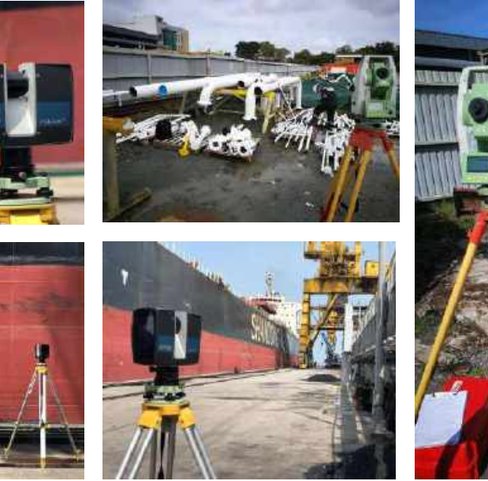

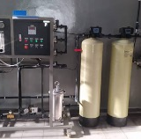
BUSINESS ACTIVITIES
Cyber Security and IT Solutions
Laser Scanning
Asset Integrity
Management System
Green Technology Solutions
CRAMS RBI
With Cyble Vision to provide cutting edge cybersecurity solutions
Laser Scan 3D, Underground Mapping, UAV/Drone, Soil Investigation, AR/VR
.
Risk Based Inspection Software for Oil and Gas and Energy Industries
Water Treatment System, Solar Panel Installation, Pump Services

Slide 6







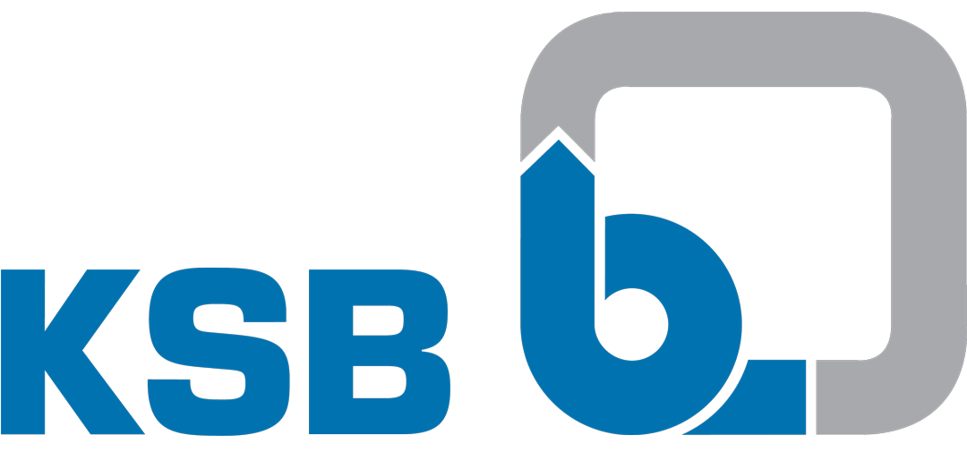
OUR PRINCIPALS
Cyber Security Software
Data Center
Multi Screw Pump (NOTOS)
Progressive Cavity Pump (NEMO)
Positive Displacement Pump (TORNADO)
API 610
ISO 5199
Gridlestone Pump
3D Scanning
Wolong bought over Brook Crompton, ATB, GE , and OLI
Concentric Butterfly Valves
DOUBLE OFFSET Butterfly Valves
TRIPLE OFFSET Butterfly Valves
GFA Partner
AC & DC Motor
Variable Speed Drives & Soft Starter
Generator Control System
GFA Partner

Slide 7





PROGRESSIVE JOURNEY OF CYBLE
5th Calendar year running, Threat Intelligence provider that has extensive expertise
Compliant with ISO 27001 and SOC2 Type 1 and Type 2
500+ customers which include Healthcare companies
200+ Employees in 15 countries
Recognized by Gartner, Forrester, Frost & Sullivan, Forbes, The Cyber Security Excellence award
Experience ranging from ex-FBI/Federal Personnel to seasoned Cyber Security experts
Backed by top VC & Corp funds
© 2024 Cyble Inc. All rights reserved.

Slide 8


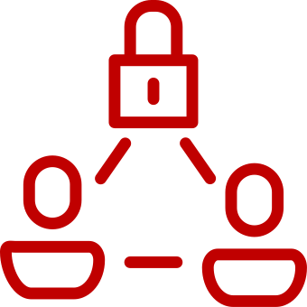




Brand Reputation Intelligence
Detect Internet Phishing & Suspicious URLs, Scams
    Detect Social media Threats, Impersonation & Frauds etc
    Fake Mobile Apps
    Website Watermarking & monitoring
Executive brand protection monitoring
Attack Surface Detection & Hunting (DRPS)
Vulnerable Infra(Assets, Ports, Vulnerabilities, Vhost, SSL Expiry, CWE)
CodeLeaks(GitHub/bitbucket/Postman/docker)
Cloud buckets leaks S3, Azure .. All the storages
Darkweb and cybercrime Intelligence
Compromised Endpoints(Creds, Documents, Cookies, PII data)
3rd Party data Breach (PII, Passwords, Hashes, Documents)
Dark & Deep web Chatters(Forums, Tor, I2P, Telegram, discord, pasties)
CC & Debit Card Leaks
IR services
Threat Actor Engagement
Request For Information Credits (External Hunting, Darkweb Research, Investigations .. )
External Forensic Investigations
Malware Research / Reverse Engineering
Takedowns
7+
Modules of
Threat Intelligence
Threat Actor Library( Alias, Target, Malwares used, News Flash, IOCs, TTPs, Newsfeeds, Advisories)
Malware Library
IOC Lookup (APIs & TAXII)
Advisories, News Feeds and News Flash
Sensor Intelligence
Threat detection rules(Yara/sigma)
OT/ICS Intelligence
Hacktivism
Malware Sandbox
Third-Party Risk Intelligence
Vendor risk score Derived from Darkweb, deep web, attack surface, public breaches, disclosures, etc …
Customizable Report & Continuous monitoring
Vulnerability Intelligence
Actively Detect Zero-day Exploits for the 3rd party tools and infra used.
Get Early signal on the internet activities on exploits
© 2024. Cyble Inc.(Leading Cyber Threat Intelligence Company). All Rights Reserved

Slide 9
THANK YOU

